Slide 1

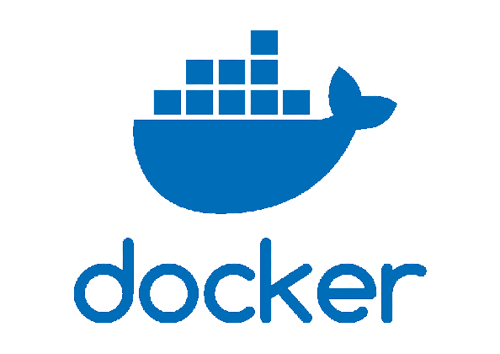
Grow Your App’s Ecosystem with Docker's Containerized Farm

Slide 2



Speakers
Rahul Miragi Senior Manager – DevOps & SRE
/in/miragirahul/
Shubham Kumar DevOps & SRE Engineer II
/in/shubham-kumar-kashyap/

Slide 3
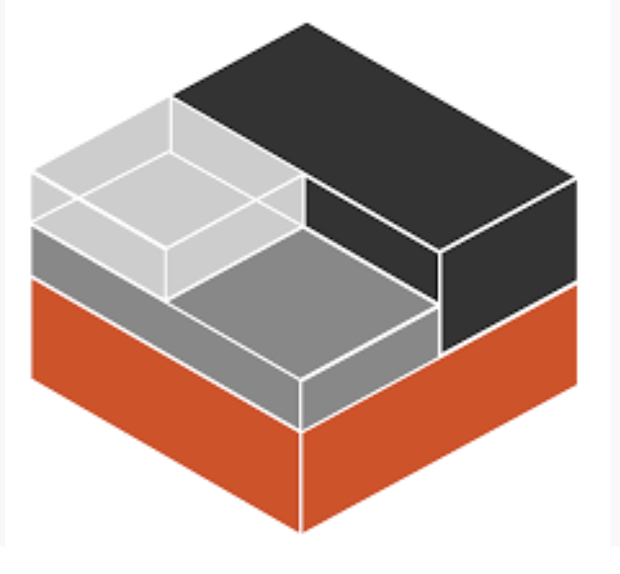
LXC Containers
LXC (Linux Containers) is an operating system-level virtualization technology that provides a lightweight virtualization solution for running multiple isolated Linux systems on a single host. LXC is often referred to as the precursor to Docker containers.
Kernel Namespace Isolation
Cgroups
Lifecycle Management

Slide 4
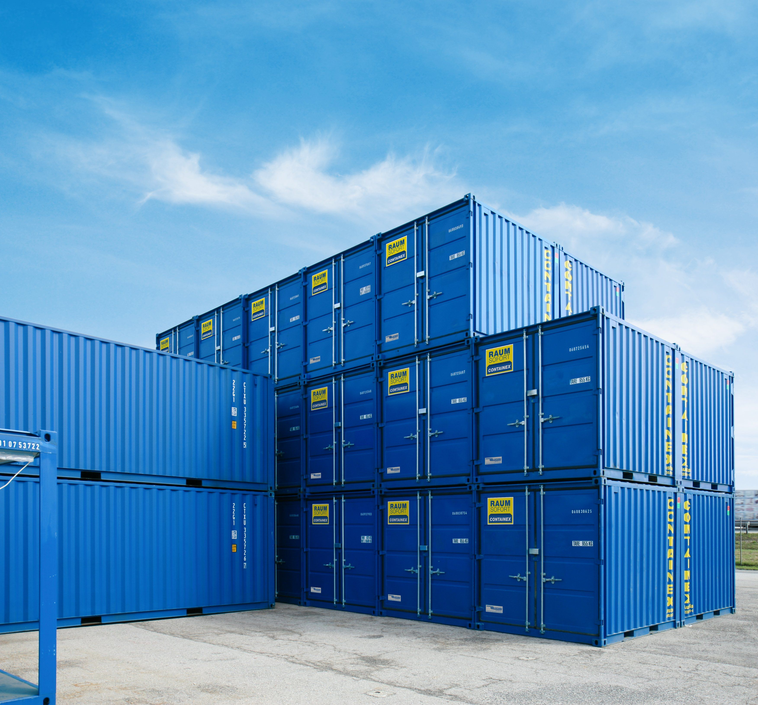
Containers
Lightweight
Portability
Consistency
Resource Efficiency
Scalability
Isolation
Rapid Deployment

Slide 5

Docker History
2013
Docker is Born. DotCloud released Docker to simplify app containerization.
2013–2014
Rapid Growth Docker gained popularity for its simplicity and efficiency. Integrated by Google, Red Hat, and AWS.
2015
Docker Inc. and OCI DotCloud renamed to Docker Inc. Launched the Open Container Initiative (OCI).
2016–2017
Expansion Introduced Docker Swarm and Docker Compose.
2018–2019
Mirantis Acquisition Mirantis acquired Docker's enterprise business in 2019. Docker focused on cloud-native tech and Docker Desktop.

Slide 6
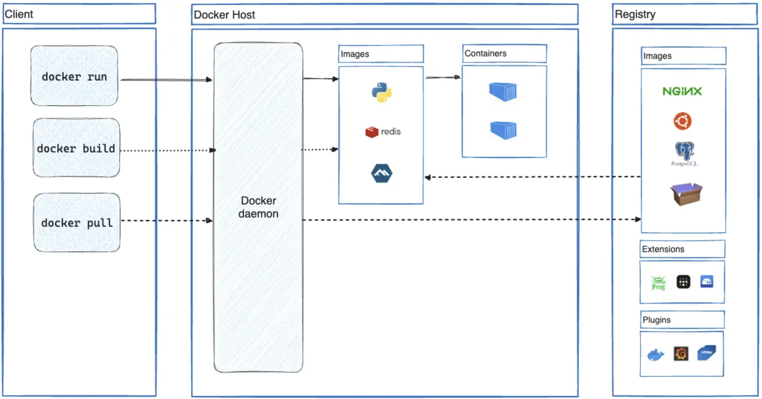
Docker Architecture

Slide 7

Docker Images
A Docker image is a lightweight, standalone, executable package that includes everything needed to run a piece of software, including the code, runtime, libraries, environment variables, and configuration files. Essentially, it is a template used to create a Docker container.
What are Docker Image Layers?
A Docker image is built up from a series of layers. Each layer represents a set of changes or instructions applied to the base image, such as file additions, modifications, or deletions. These layers are stacked on top of each other to form the final image.
Key Characteristics of Docker Image Layers:
Read-Only
Union File System
Reusability
Efficiency

Slide 8

Docker Registry
A Docker Registry is a server-side application that stores and lets you distribute Docker images. It can be used to host images privately or publicly. Docker provides an open-source registry implementation called Docker Registry.
Storage and Distribution: Stores Docker images and allows them to be shared among multiple users or systems.
Private Registries: Organizations can deploy their own registry to have full control over the distribution of their Docker images.

Slide 9

Docker Hub
Docker Hub is a cloud-based registry service provided by Docker Inc.
Public and Private Repositories
Automated Builds
Official Images
Community Contributions

Slide 10
Docker Networking
Driver | Description
bridge | The default network driver.
host | Remove network isolation between the container and the Docker host.
none | Completely isolate a container from the host and other containers.
overlay | Overlay networks connect multiple Docker daemons together.
ipvlan | IPvlan networks provide full control over both IPv4 and IPv6 addressing.
macvlan | Assign a MAC address to a container.

Slide 11
Let’s dive in

Slide 12
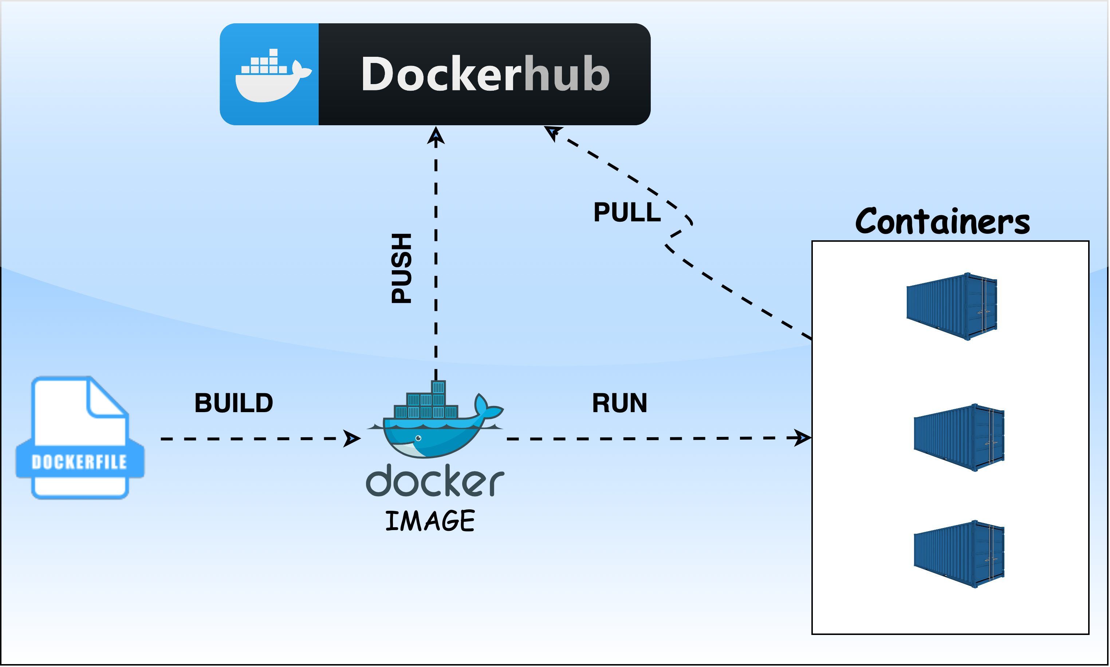
Dockerfile
A Dockerfile is a text document that contains all the commands to assemble an image.
It defines the environment and the instructions for creating Docker containers.
Understanding Dockerfiles is crucial for automating the deployment of applications in containers.

Slide 13
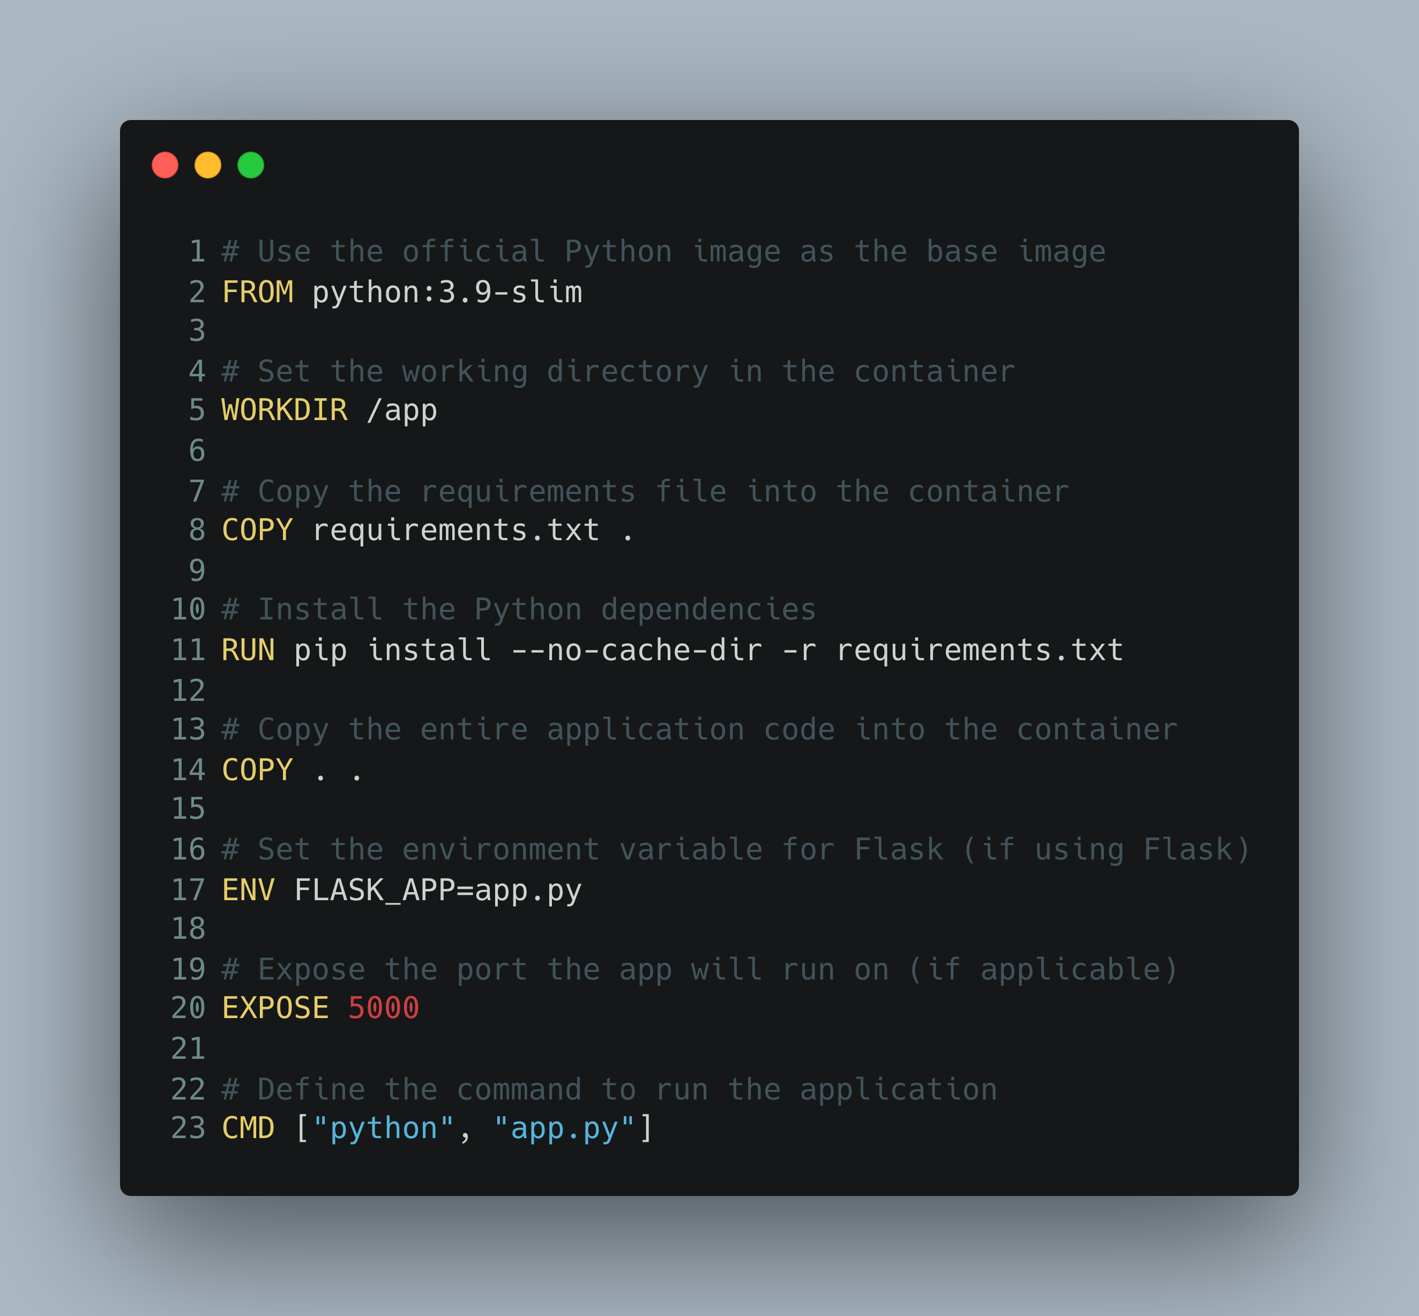







Sample Dockerfile
FROM: Specifies the Base Image
WORKDIR: sets the working directory for all the subsequent Dockerfile instructions
COPY & ADD: Copy files from the local & remote into the container
RUN: Executes command in a new layer on top of the current image
ENV: Sets Environment variables
EXPOSE: Informs Docker that the container listens on the specifies network port at runtime
CMD: provides a defaults for executing a container
ENTRYPOINT: Configures a container that will run as an executable

Slide 14
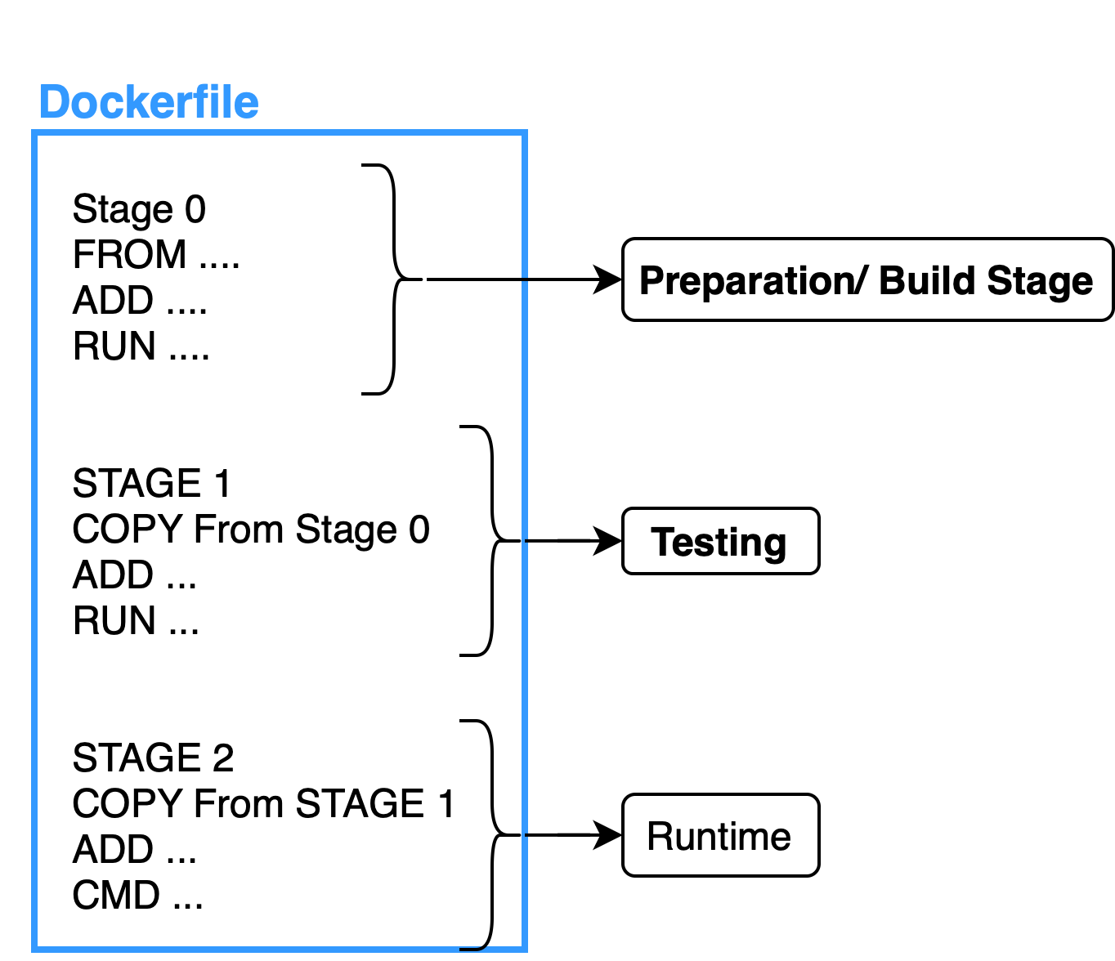
Multi-Stage Dockerfile
A multi-stage Dockerfile is a feature in Docker that allows users to create Docker images with multiple build stages. Each build stage can include different dependencies, tools & configurations.
Faster deployment
Security
Easy to read and maintain
Advantages:

Slide 15
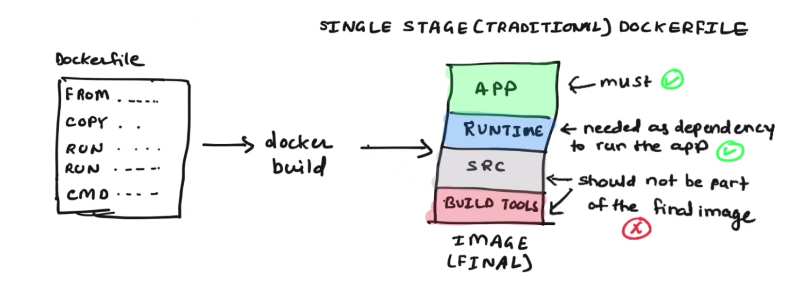
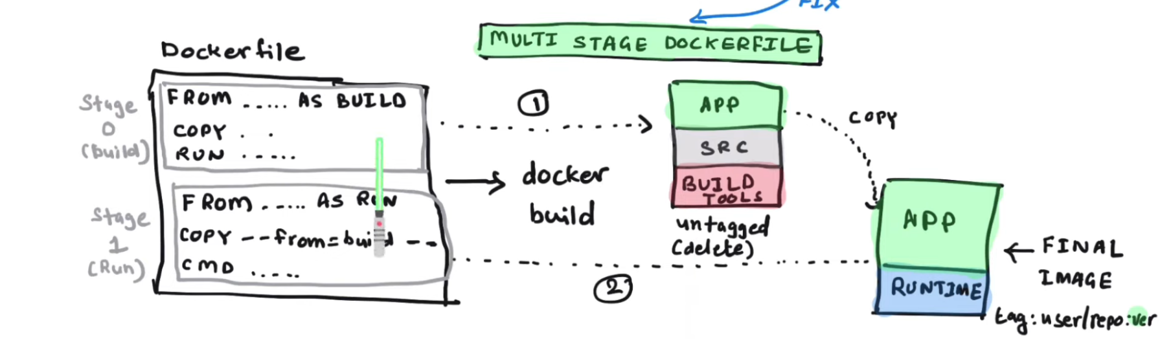

Slide 16
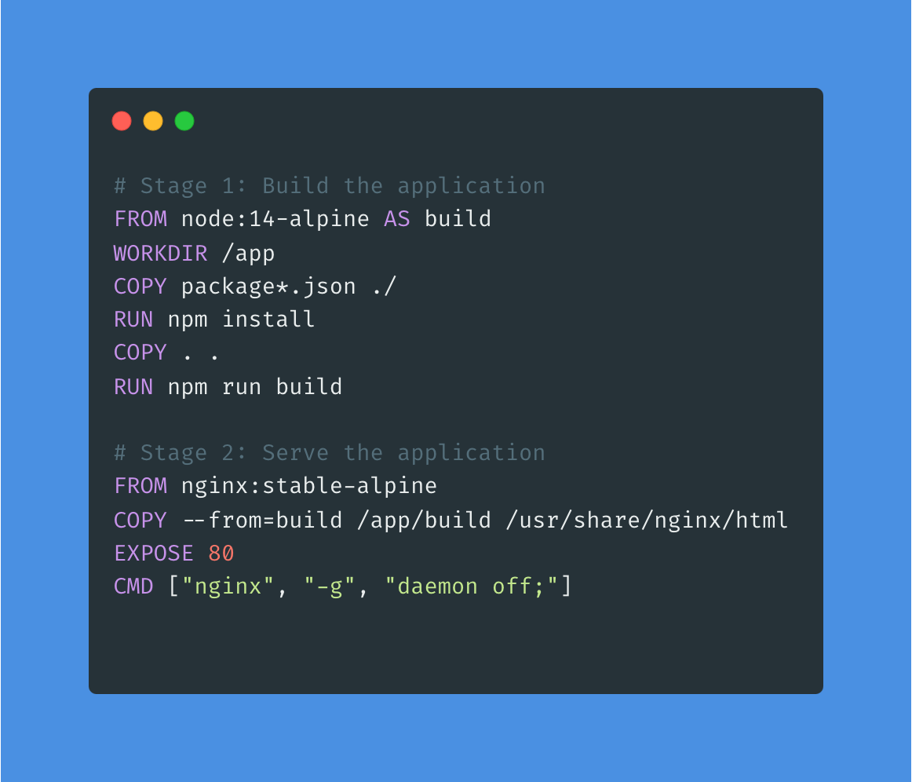
Multi-Stage Dockerfile Example

Slide 17
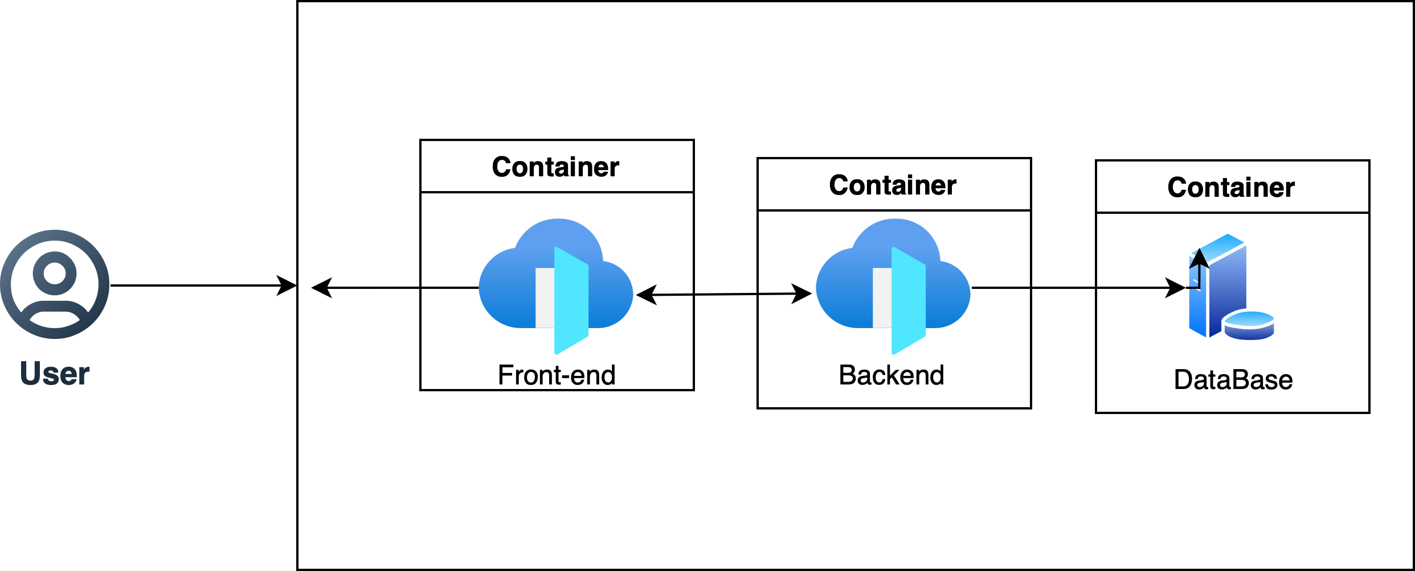
Docker Compose
Docker Compose simplifies the management of multi-container applications using a single YAML file to define services, networks, and volumes. With just one command, you can set up and start all services specified in your configuration. It's versatile, supporting environments like production, staging, development, testing, and CI workflows, and offers commands to manage your application's entire lifecycle.

Slide 18
Why use Docker Compose?
Key Benefits
Define and manage services, networks, and volumes in a single YAML file
Start/stop entire application stack with a single command
Supports various environments (dev, staging, prod, CI/CD)
Facilitates collaboration and streamlines workflows
Leverages Docker's portability and scalability
Common Use Cases
Development Environments
Isolated environments for development and testing
Document and configure service dependencies
Simplify "getting started" guides
Automated Testing
Create and destroy isolated testing environments
Integrate with CI/CD pipelines
Single Host Deployments
Deploy multi-container applications on a single host
Suitable for small-scale production deployments

Slide 19
How to Use Docker Compose?
Step 1: Define your app's environment with a docker-compose.yml file.
Step 2: Run docker-compose up to start your entire application.
Commands:
docker-compose build — Build or rebuild services.
docker-compose up. — Start services.
docker-compose down — Stop and remove containers, networks, images, and volumes.
docker-compose stop — Stops running containers without removing them.
docker-compose logs — View output from containers.

Slide 20
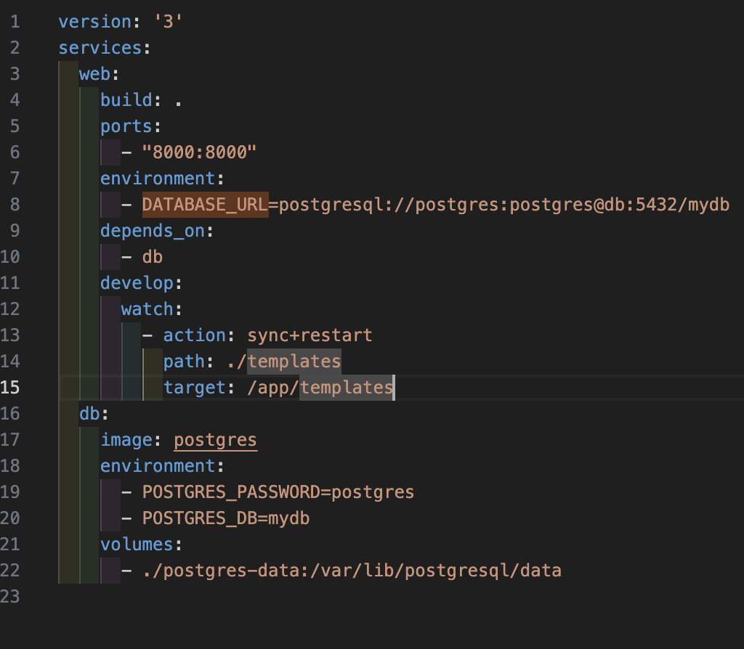
Docker Compose Example
A simple web application using Python Flask and a PostgreSQL database.

Slide 21
Demo

Slide 22

QUIZ
https://quiz.konfhub.com/q/docker-vit

Slide 23

Q&A

Slide 24
Thank You
Join our meetup group "Pune AgTech Community Group": https://www.meetup.com/pune-agtech-community-group/

